Slide 1
Delegated Access Training “Share My Information”
June 28, 2017

Slide 2
What is Delegated Access?
Allows students the option to let others have access to specific information in Campus Connect.
Student (delegator) may delegate specific information to parents, guardians or others (proxy).

Slide 3
What can be shared?
Currently the following information for a student can be shared in Campus Connect:
Class Schedule - List of Courses, Times and Locations
Contact Information - Addresses, Phone Numbers, Emails
Course History - View Courses taken, Transfer Credit and Grades
Emergency Contacts - Names and Numbers
*Financial Aid - Cost of Attendance, Award and Disbursement
Holds - Information regarding Academic and Financial holds
*Phone/ In-Person Access – Passcode for Parents/ Others
To Do List - Information regarding Academic and Financial to-dos
*New

Slide 4
Advantages of Delegated Access
Reduces phone traffic and the number of disgruntled parents
Creates a mechanism that students can share information appropriately
FERPA compliant
New functionality allows proxies (parents or others) to have conversations on behalf of the student regarding specific academic and financial information with staff

Slide 5
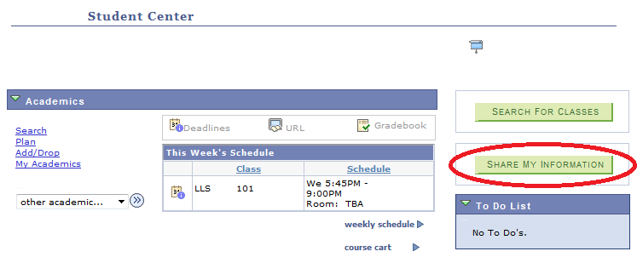
Share My Information (Student)
Students access the “Share My Information” link in the
Campus Connect > Student Center.

Slide 6
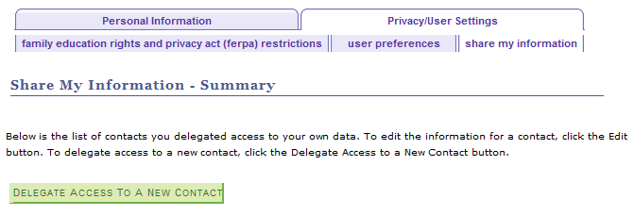
Share My Information (Student)
Select “Delegate Access To A New Contact”

Slide 7
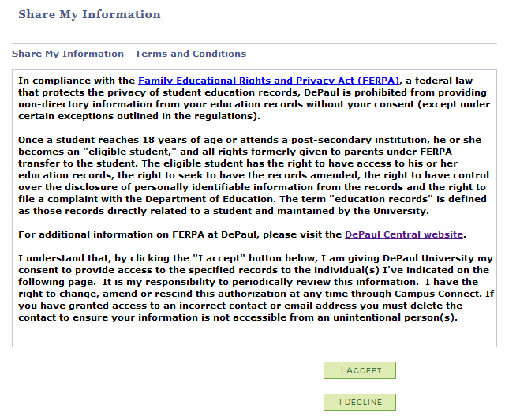
Student Terms and Conditions (Student)

Slide 8
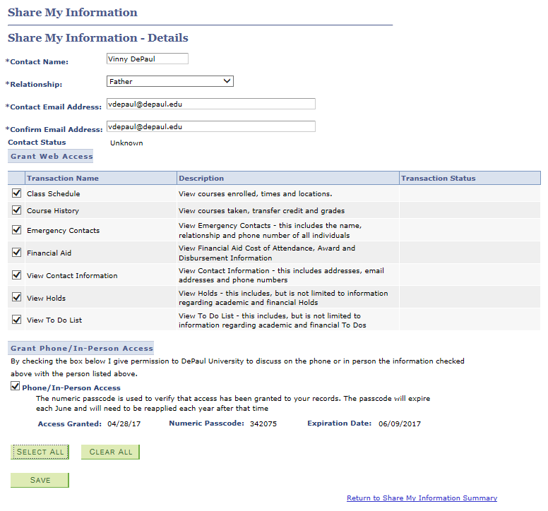
Contact Details and Selecting Access (Student)
Select
Access

Slide 9
Grant Phone/ In-Person Access (Student)
When a student selects phone/ in-person access, it generates a passcode that will be provided to the proxy (parent). It also indicates the date it was granted and the expiration date.
Note that the passcode will expire in June and will need to be selected again by the student for the next academic year.

Slide 10
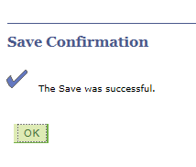
Selecting Access (Student)
Once the student is finished selecting access, a message will display indicating that the Proxy (Parent) will receive an email regarding their access. The Delegator (Student) will get an email confirming that they have granted access and a copy of that email is stored in their Notifications Center.

Slide 11
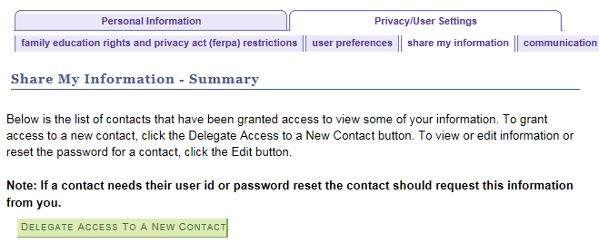
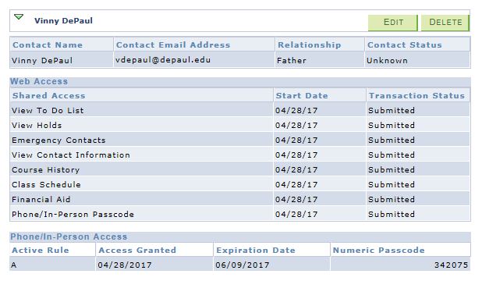
Shared Access Summary (Student)
Students may edit or delete access here.
The Transaction Status of submitted indicates that the parent must still set up their account.

Slide 12
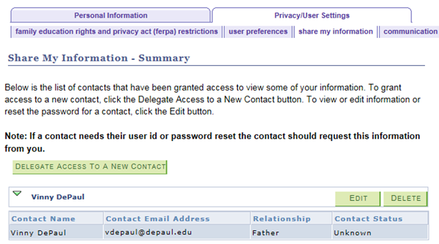
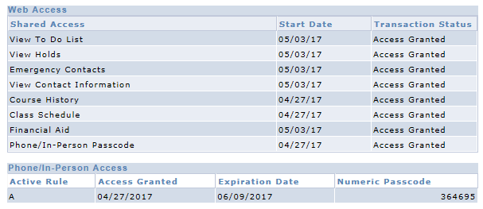
Shared Access Summary (Student)
The Transaction Status of Access Granted indicates that the parent has set up their account.

Slide 13
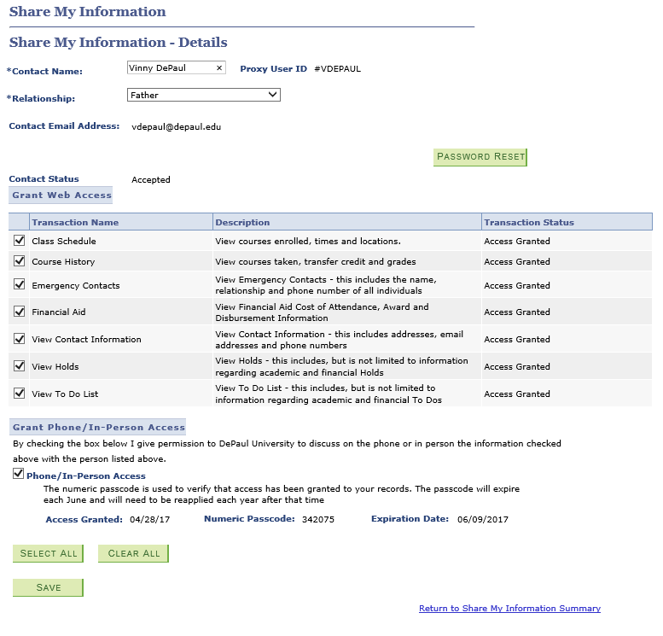
Edit Shared Access (Student)
Students may view the Proxy User ID, Reset the Password or Edit Access.

Slide 14
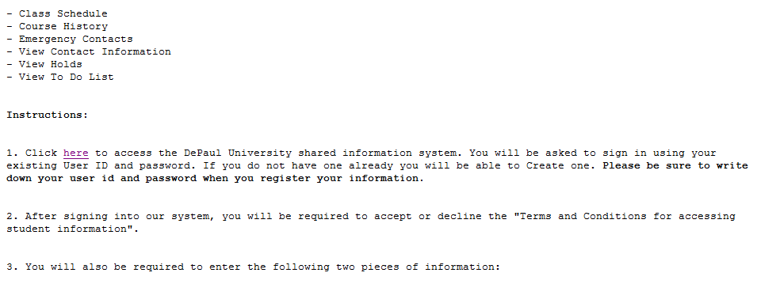
Email Notification (Parent)
The “Proxy” would then follow the instructions to set up their account and access the student’s information.

Slide 15
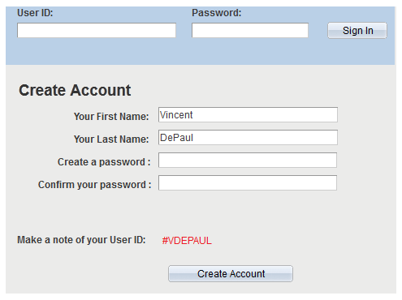
New User Setup (Parent)
The “Proxy” sets up their account and is given a new #User ID and creates a password.

Slide 16
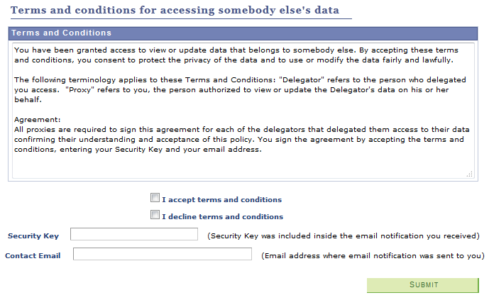
Terms and Conditions (Parent)
The “Proxy” must accept the Terms and Conditions,
enter Security Key and Email Address from the notification.

Slide 17
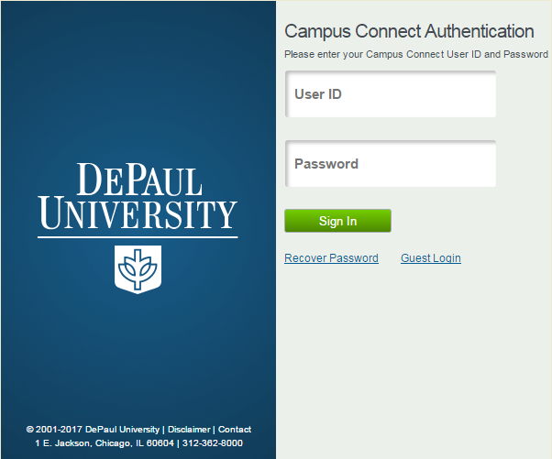
Campus Connect Login (Parent)
The “Proxy” will then be prompted to login using their #username,
and password that they recently set up.

Slide 18
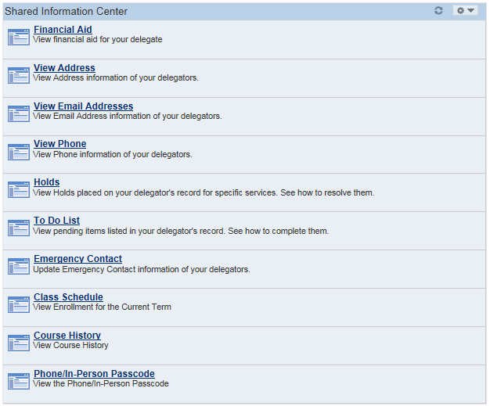
Campus Connect View (Parent)
The Proxies (parent or other) may then select any of the available links to view the corresponding information.
Proxies do not have any transactional ability, they may only view the information.

Slide 19
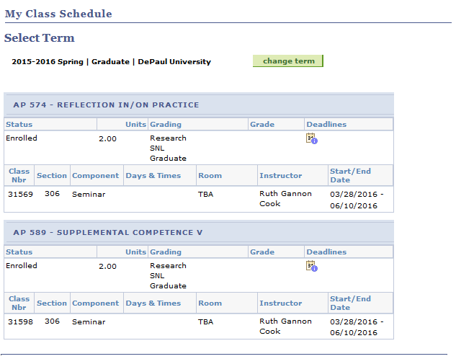
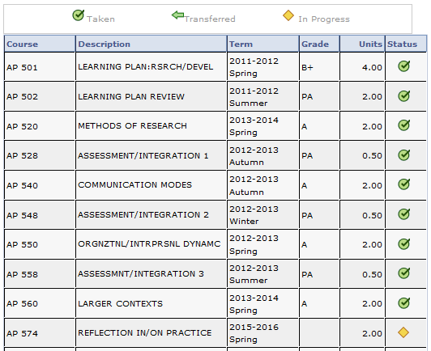
Campus Connect View (Parent)

Slide 20
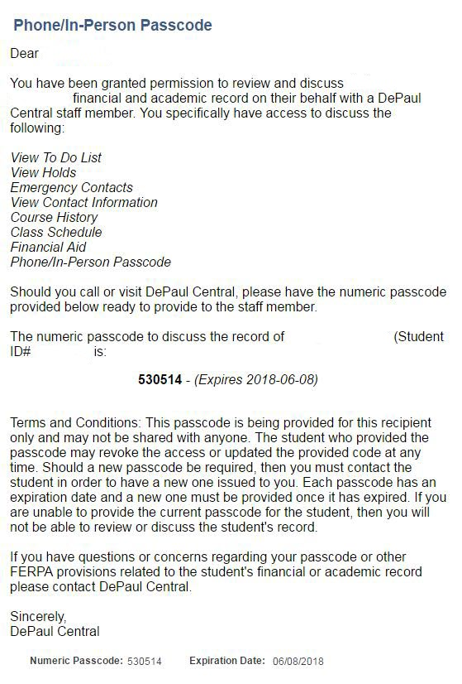
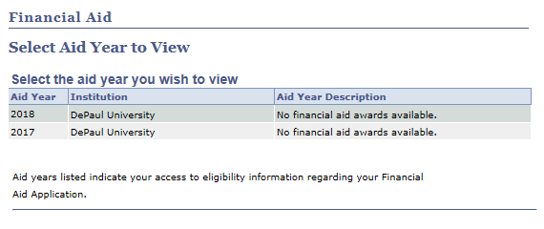
Campus Connect View (Parent)

Slide 21
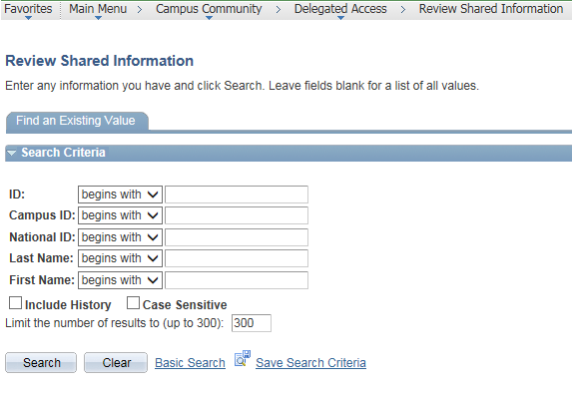
Administrative View (Staff)
Staff may review shared information through the Delegated Access Admin page. Simply search the student by ID or Name.

Slide 22
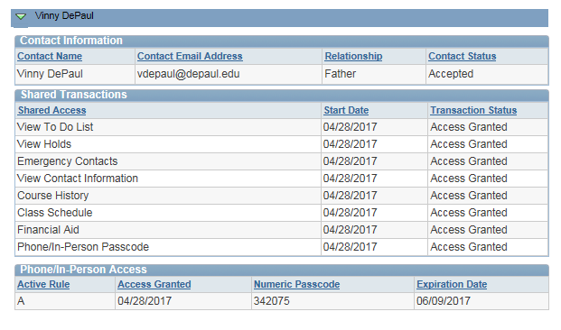
Administrative View (Staff)
Staff can then verify what information the Proxy (parent or other) has been granted access to.
Staff MUST ensure that the Transaction Status is set to “Access Granted” and that the access has not expired.

Slide 23
Questions?

