Slide 1
QUANTITATIVE ANALYSIS
Graduate Thesis & Dissertation Conference
Saturday, February 4, 2017
Jen Sweet
Associate Director; Office for Teaching, Learning, and Assessment
Shannon Milligan
Assessment Coordinator; Faculty Center for Ignatian Pedagogy
Notes:
Shannon

Slide 2
SESSION AGENDA
Part I: Types of Data
Part II: Types of Quantitative Data Analyses
Part III: Tools for Data Analyses
Notes:
Shannon

Slide 3
SESSION OBJECTIVES
Participants will be able to:
Differentiate between different types of data and identify which analyses are appropriate for each type
Identify tools appropriate for analyzing quantitative data
Notes:
Shannon

Slide 4
Types of Data
Notes:
Jen

Slide 5
Types of Data
Nominal/Categorical
Ordinal
Interval
Ratio/Scale
Notes:
Jen

Slide 6
Nominal/Categorical Data
Names Data (or arranges data into categories).
No numbers associated with this type of data
No Concept of Degree or Order
No category is “higher” or “better” than another
Analysis
It is not appropriate to perform any arithmetic operations on nominal data (such as calculating or comparing means).
Frequencies and Percentages of the number of cases that fall into each category may be the most appropriate type of analysis for nominal data.
Notes:
Jen

Slide 7
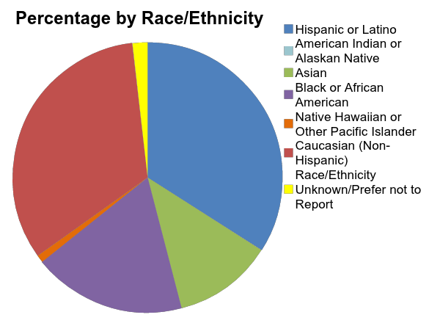
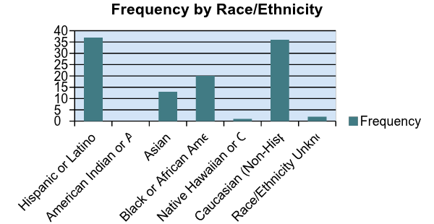
Examples of Nominal Data Analysis
Example: Race/Ethnicity
Table:
Graph:
Chart:
Race/Ethnicity | Frequency | Percentage
Hispanic or Latino | 37 | 34.0%
American Indian or Alaskan Native | 0 | 0%
Asian | 13 | 11.9%
Black or African American | 20 | 18.3%
Native Hawaiian or Other Pacific Islander | 1 | 0.9%
Caucasian (Non-Hispanic) | 36 | 33.0%
Race/Ethnicity Unknown/Prefer not to Report | 2 | 1.8%
Notes:
Jen

Slide 8
Ordinal Data
Ordinal data specifies an order to the information. However, the distance between each data point is not fixed or known
Analysis
It is not appropriate to perform any arithmetic operations on ordinal data (such as calculating or comparing means).
Frequencies and Percentages of the number of cases that fall into each category may be the most appropriate type of analysis for nominal data.
Many people calculate means anyhow
Important to know how violation of assumptions for conducting arithmetical operations affects interpretation of results
E.g. 4 is not double the score of 2; 3.5 is not halfway between 3 and 4
Notes:
Jen

Slide 9
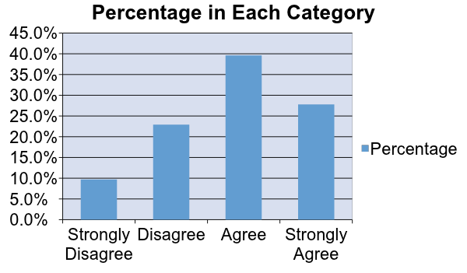
Examples of Ordinal Data
Example: Likert scales (agreement scale)
Table
Graph
 | Strongly Disagree | Disagree | Agree | Strongly Agree
Frequency | 14 | 33 | 57 | 40
Percentage | 9.7% | 22.9% | 39.6% | 27.8%
Notes:
Jen

Slide 10
Interval Data
Interval data specifies an order to information with equal, fixed, and measurable distances between data points. (No absolute zero)
Analysis – Interval data meets the assumptions necessary to conduct certain arithmetic operations
addition and subtraction
violates assumptions to perform multiplication or division
With careful interpretation, use of any arithmetic operation may be justifiable.
without a meaningful (absolute) zero, a 4 not necessarily double a score of 2.
Possible Analyses (with careful interpretation):
measures of central tendency
measures of distribution spread
measures of relationship
mean comparisons
Notes:
Jen

Slide 11
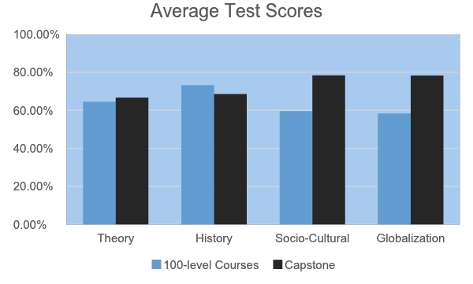
Examples of Interval Data
Example: Scores on a Test
Table
Graph
Average Test Scores
Domain | Test Items | 100-level Courses | Capstone
Theory | 1, 4, 9, 11,15, 20, 25, 29 | 64.52 | 66.73
History | 2, 7, 12, 15, 22, 28, 30 | 73.26 | 68.54
Socio-Cultural | 3, 5, 8, 10, 13, 14, 18, 24, 27 | 59.63 | 78.36
Globalization | 6, 16, 17,19, 21, 23, 26, 27 | 58.29 | 78.31
Notes:
Jen

Slide 12
Ratio/Scale Data
Ratio data specifies an order and fixed interval between data points. Ratio data also has a meaningful (absolute) zero.
zero that indicates a complete lack of whatever is being measured
Possible Analyses:
measures of central tendency
measures of distribution spread
measures of relationship
mean comparisons
Same as for interval data
Notes:
Jen

Slide 13
Examples of Ratio/Scale Data
Weight, height, time, sometimes temperature
Counts (ex. number of people who attended a given activity)
Notes:
Jen

Slide 14
Distinguishing Between Interval and Ratio Data
Is 0 absolute?
Examples of non-absolute zeros
Selection of zero is somewhat arbitrary
Longitude: 0 = Royal Observatory (Greenwich, England)
prior to 1884, included El Hierro, Rome, Copenhagen, Jerusalem, Saint Petersburg, Paris, Philadelphia, and Washington D.C.
Altitude: 0 = Sea Level
Notes:
Jen

Slide 15
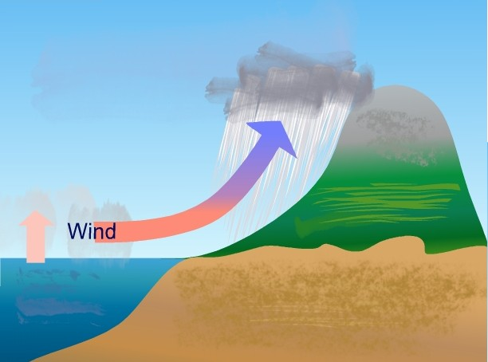
Illustration of Interval – Sea Level
Denver (above 0)
Denver Altitude: +5, 280 feet
Sea Level (0)
New Orleans (below 0)
New Orleans Altitude: -6.5 feet
http://upload.wikimedia.org/wikipedia/commons/8/88/Steigungsregen.jpg
Notes:
Jen

Slide 16
Bottom Line: Interval and Ratio
Both types of data can be analyzed using the same techniques
The difference is in the interpretation of results
A zero on a test doesn’t necessarily mean that the student knows nothing about the content (Interval)
Zero people in a room means that there isn’t anyone there (hopefully) (Ratio)
A person who scores a 100 on a test isn’t necessarily twice as smart as someone who gets a 50 (Interval)
An NFL linebacker probably does weigh 3 times as much as Shannon (Ratio)
Notes:
Jen

Slide 17
Types of Quantitative Data Analyses
Notes:
Shannon

Slide 18
Common Types of Quantitative Data Analysis
Measures of Central Tendency
Measures of Distribution (Spread)
Measures of Relationship
Measures of Comparison
Notes:
Shannon

Slide 19
MEASURES OF CENTRAL TENDENCY
Key question = what is the middle?
Three Primary Measures:
Mean-the arithmetic average
Median-the middle; 50% of data points are above and 50% are below
Mode-the most commonly occurring result
Example Data:
Mean: 20.3
Median: 5.5
Mode: 7
Individual | Result
1 | 2
2 | 150
3 | 4
4 | 18
5 | 1
6 | 7
7 | 3
8 | 6
9 | 7
10 | 5
Notes:
Shannon

Slide 20
ADVANTAGES AND DISADVANTAGES
 | Mean | Median | Mode
Advantages | Most widely used measure of central tendency Broadly recognized measure | This measure is not sensitive to outliers | Can give you better information about the distribution of your results Does not assume your results are normally distributed Can use with categorical data
Disadvantages | Sensitive to outliers in data Example = Annual Salaries In 2013, mean household income in U.S. = $87,200 median household income = $46,700¹ | This measure is not as well-recognized by all audiences | May be more difficult to interpret, especially when there are multiple modes General audiences will probably be least familiar with this measure
¹Board of Governors Federal Reserve System (2014). Federal Reserve Bulletin. https://www.federalreserve.gov/pubs/bulletin/2014/pdf/scf14.pdf
Notes:
Shannon
Federal Government reported 4% growth in household incomes between 2010 and 2013…however, median household incomes FELL 5% (gains were all at the top…federal government was reporting based on means)

Slide 21
Measures of Distribution (Spread)
Most commonly used is the standard deviation
What is it?
A relative measure of how far individual data points are from the mean of the data set
Why is it important?
To give a sense of how spread out the data are overall-are most cases close to the mean?
To give a sense of whether an observation is an outlier
To determine whether the observation is likely due to chance
Notes:
Shannon

Slide 22
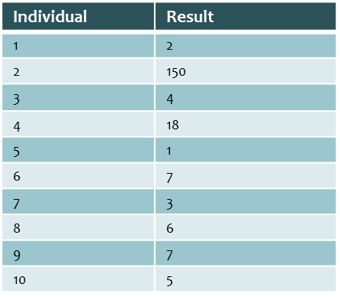
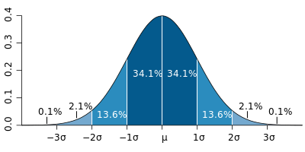
Measures of Distribution (Spread)
Mean of data set = 20.3
Standard Deviation = 43.5
43.5 is very large, which means the data are quite spread out
20.3
63.8
107.3
150.8
Notes:
Shannon

Slide 23
Measures of Relationship
Correlation: tells us whether and to what extent two variables are related
This relationship can be:
Positive: variables are related and increase together
Negative: variables are related but one decreases as the other increases
Non-existent (0)
Size of correlation indicates strength of relationship (e.g. totally positively correlated = +1, totally negatively correlated = -1)
Advantage: Good for insight/planning and directions for future study
Notes:
Shannon

Slide 24
Measures of Relationship
Disadvantage: correlation is often conflated with causation
Correlation says that a relationship exists (or doesn’t), not why it exists
Does not account for all possible variables
Example: there is a strong positive correlation between temperature and ice cream consumption
Do high temperatures cause increased ice cream consumption?
Does higher ice cream consumption cause an increase in temperature?
Notes:
Shannon

Slide 25
Measures of Comparison
Examples: Pre- Post- Data;
Primary Questions
Is there a difference?
Is the difference significant?
More Sophisticated Analyses: what was the cause of the significant result
ad hoc analyses
Notes:
Shannon

Slide 26
Analyses for Comparison/Prediction
General Linear Model (GLM)
T-test
Comparison of two quantities (ex. pre- post- score averages)
ANOVA
Comparison of results for two groups (ex. pre- post- score averages for males versus females)
Multiple Regression
Comparison of results for two groups; two or more independent variables (ex. Pre- post- score averages by gender and ethnicity)
Multivariate
Comparison of two or more dependent variables; one or more independent variables (ex. Pre- post- score averages and internship ratings by gender and ethnicity)
Notes:
Shannon

Slide 27
Analysis Decision Guide
In a nutshell…
with nominal data, it may be best to stick to frequencies and percentages!
Adapted from http://www.csun.edu/~amarenco/Fcs%20682/When%20to%20use%20what%20test.pdf
 | Nominal data | Ordinal data | Interval/ratio data
Group differences | Chi-Square | Chi-Square | T-test, ANOVA, MANOVA
Relationships |  |  | Correlation
Prediction |  |  | Linear Regression, Multiple Regression
Notes:
Shannon

Slide 28
Tools for Quantitative Data Analyses

Slide 29
Common Data Analysis Tools
SPSS/SAS
Excel
R
Notes:
Shannon

Slide 30
SPSS/SAS
Advantages
Widely-used
User-friendly “plug and chug”
Does all calculations for you
Disadvantages
Requires some training
A lot of options; need to know how to select appropriate options for the analysis you would like to run
Need to be able to read and appropriately interpret output
Potential problem = too easy to run analyses without understanding them
May be expensive (DePaul no longer has free access outside computer labs)
Limited data visualization capabilities
Notes:
Shannon

Slide 31
Excel
Advantages
Widely-used and readily available
For most no additional training will be required to use Excel
Easy to use with minimal training
Integrated ability to visualize data
Create graphs, charts, etc.
Disadvantages
Limited data-analysis capabilities
Good for frequencies, percentages, distributions, means, but not capable of other statistical analyses.
Notes:
Shannon

Slide 32
R
Advantages
Free
Very Flexible
No pre-sets; can be programmed
Can accommodate more complex statistical modeling/analyses
Robust data visualization capabilities
Disadvantage
Requires programming skills (though you can find on Google)
You need to know what you are doing or feel comfortable teaching yourself
Notes:
Shannon

Slide 33
Questions?
Notes:
Shannon/Jen

Slide 34
Contact Information
Shannon Milligan
Assessment Coordinator
Faculty Center for Ignatian Pedagogy
smilligan@luc.edu
Jen Sweet
Associate Director
Office for Teaching, Learning, and Assessment
jsweet2@depaul.edu
Notes:
Shannon/Jen

