Slide 1
Introduction to
Qualitative Research
Ellen Meents-DeCaigny,
Assistant Vice President for Student Affairs, DePaul University

Slide 2
What is your interest in qualitative research?
Notes:
Your name, the program you are in, your interest in qual research – either a specific project you are working on or a general interest

Slide 3
Workshop Overview
Why Collect Qualitative Data
Types of Qualitative Data
Key Points of Analysis
Steps to Developing Themes
Notes:
Ellen

Slide 4
Why Collect Qualitative Data
To understand people’s life histories, everyday behavior or personal experiences
Allows for flexibility, subjectivity and deeper exploration
Focuses on words and images
Notes:
Does anyone have an example of a project they are working on or considering?
Can share my project.

Slide 5
Types of Qualitative Research
Phenomenology
Ethnography
Grounded theory
Case study
Notes:
Ellen
The first major approach to qualitative research is phenomenology (i.e., the descriptive study of how individuals experience a phenomenon).
Here is the foundational question in phenomenology: What is the meaning, structure, and essence of the lived experience of this phenomenon by an individual or by many individuals?
The researcher tries to gain access to individuals’ life-worlds, which is their world of experience; it is where consciousness exists.
The second major approach to qualitative research is ethnography (i.e., the discovery and description of the culture of a group of people).
Here is the foundational question in ethnography: What are the cultural characteristics of this group of people or of this cultural scene?
Because ethnography originates in the discipline of Anthropology, the concept of culture is of central importance.
Ethnology (the comparative study of cultural groups).
Ethnohistory (the study of the cultural past of a group of people). An ethnohistory is often done in the early stages of a standard ethnography in order to get a sense of the group’s cultural history.
The third major approach to qualitative research is case study research (i.e., the detailed account and analysis of one or more cases).
Here is the foundational question in case study research: What are the characteristics of this single case or of these comparison cases?
A case is a bounded system (e.g., a person, a group, an activity, a process).
The fourth major approach to qualitative research is grounded theory (i.e., the development of inductive, “bottom-up,” theory that is “grounded” directly in the empirical data).
Here is the foundational question in grounded theory: What theory or explanation emerges from an analysis of the data collected about this phenomenon?

Slide 6
Types of Qualitative Data
Written Documents
Observation
Focus Groups (Group Interviews)
Interviews
Photo Journals
Mind Mapping
Notes:
Ellen
Reorder this? To be cohesive with what we’ll talk about?

Slide 7
Begin with the End in Mind
No matter what type of data collection, it is important to determine the analysis strategy in the beginning
Notes:
Ellen

Slide 8
Analysis Considerations
When data is collected
How data is collected
Who is collecting data
The setting in which data is collected
Notes:
The best time based on the topic and the experience you are trying to understand.

Slide 9
Document Analysis
Notes:
Stacy

Slide 10
Document Analysis
Research-Generated Documents - For what purpose were the documents produced?
Our (the investigator’s) responsibility is to ask questions regarding the documents origin, reasons for being written, its author and the context in which it was written.
Notes:
Stacy

Slide 11
Primary Sources
Reflection papers are primary sources
The originator of the document is recounting a firsthand experience
The best primary sources are recorded closest in time and place to the phenomenon of interest by a qualified person
Notes:
Stacy

Slide 12
Limitations of Personal Documents
Subject to purposeful or non-purposeful deception.
Distortion may be unintentional: writer is unaware of biases or simply does not remember accurately.
Differences caused by manner in which data is collected.
Notes:
Stacy

Slide 13
Strengths of Personal Documents
Can yield more data or better data than other tactics
Easily accessible and contains information that would take enormous time and effort to gather
May be the only means for studying certain problems
Stability - the presence of the investigator does not alter what is being studied
Notes:
Stacy

Slide 14
Focus Groups
Notes:
Ellen

Slide 15
Strengths of Focus Groups
“Focus groups provide an excellent opportunity to listen to the voices of students, explore issues in depth, and obtain insights that might not occur without the discussion they provide.”
(Palomba & Banta, 1999, p. 196-197)
Notes:
Ellen

Slide 16
Purpose of Focus Groups
Gather information about a specific topic
Group environment
Allow interaction and discussion by participants
Notes:
Ellen

Slide 17
Limitations of Focus Groups
Group influence
Subject to purposeful or non-purposeful deception
Differences caused by manner in which data is collected
Notes:
Ellen

Slide 18
Guiding Principles for Asking Focus Group Questions
Be conversational
Be clear
Seek Help
Notes:
Ellen
Conversational
Wording of the questions should be direct, forthright, comfortable, and simple
Exp. What would it take for this program to get an A?
Be Clear
Short, one dimensional, jargon-free (ACRONYMS)
Exp. What way was the program useful and practical? (Multi-dimensional)
Seek Help
Test questions with people similar to your target audience

Slide 19
Categories of Focus Group Questions
  Opening Question
  Introductory Questions
  Transition Questions
  Key Questions
  Ending Questions
Notes:
Ellen
There is a method to writing a good fg protocol.
Opening – Participants get acquainted and feel connected
Introductory – Begins discussion topic
Transition – Moves smoothly and seamlessly to key questions
Key – Obtains insight on areas of central concern for the study
Ending – Helps investigators determine where to place emphasis and bring closure to the discussion

Slide 20
Sequencing Focus Group Questions
Provide background information
General questions before specifics
Positive questions before negative questions
Consistency is important
Usually questions are not changed
Notes:
Ellen

Slide 21
Focus Group Analysis is Unique
Data collection through observation, conversation and other means (demographics)
Data derived from group process in a focused manner (participant influence)
Silence does not imply lack of opinion
Important to note body language, intensity and non-verbal interactions
Notes:
Ellen

Slide 22
OBSERVATIONS
Notes:
Stacy

Slide 23
Purpose of Observations
To watch the behavioral patterns of people (Johnson and Christensen, 2008)
To provide a firsthand account of the situation under study (Merriam, 2009)
Allows for data collection “when people cannot or will not discuss the research topic” (Merriam, 2009, p. 136)
Notes:
Stacy
Purpose before Strengths

Slide 24
Strengths of Observations
“Being alive renders us natural observers of our everyday world and our behavior in it . . . Most of this observation is routine – largely unconscious and unsystematic.”
- Merriam, 2009, p. 117
Notes:
Stacy
Allows us to pay special attention to a few things which others ordinarily give only passing attention (Merriam, p. 118)

Slide 25
Limitations of Observations
Highly subjective leads to unreliable reporting of perception
Subject to be intertwined with informal interviews and conversations innate to fieldwork
Trustworthiness of results often questioned
Notes:
Stacy
Oftentimes requires additional data collection methods for data methods triangulation

Slide 26
What to Observe
The physical setting
The participants
Activities and interactions
Conversation
Subtle Factors
Your own behavior
Refer to the Participant and Direct Observation Guide Template
Notes:
Stacy
Note that no one can observe everything!
Consider too the relationship between observer and the observed Merriam, p. 124 . . . Emphasize working in teams here
Complete participant
Participant as observer . . . Can be considered a “schizophrenic activity” p. 126
Observer as participant
Complete observer

Slide 27
Analysis
Notes:
Ellen

Slide 28
Analysis Strategies
Select a sample set of data, when possible
Depending on the size of the project and your interest, there is qualitative research software that can be helpful
Notes:
Ellen
Qualitative analysis takes time! Share analysis responsibilities with colleagues. It not only lightens the burden, but it helps to educate others about the program being assessed. Just like we encourage departments to help each other facilitate FG, it can be a group process to analyze the data. Plus, having more than one person analyze increased validity.

Slide 29
Important Principles of Analysis
Your research question(s) must guide the analysis
Do not get locked into one way of thinking
Let the words and actions of your participants guide your analysis
Notes:
Ellen

Slide 30
Important Principles of Analysis
Questions are the raw material of analysis
Effective analysis goes beyond words
Analysis must be practical
Analysis reflects not what participants should be saying, but what they are saying
Notes:
Ellen

Slide 31
Considerations for Qualitative Analysis
Consider the . . .
words
context
internal consistency
frequency of comments
extensiveness of comments
intensity of comments
specificity of responses
what was not said
Find the big ideas!
Notes:
Ellen

Slide 32
Analysis Must Be Systematic
Sequence questions
Be consistent in capturing data (tape recording, notes, papers, etc.)
Maintain records of coding the data
Consider using participant verification (e-mail)
Notes:
Ellen

Slide 33
Analysis Must Be Verifiable
Another professional should arrive at similar conclusions
Keep track of everything you do during analysis (research memo or journal)
Notes:
Ellen

Slide 34
Developing Themes
Notes:
Stacy – Do you want to do this section or do you want me to?

Slide 35
Coding
Definition: Combining text to build a broad picture of the data
  Developing categories
  Organizing into themes
  Substantiated by evidence and quotes

Slide 36
Developing Codes
1. Read all documents thoroughly
  Help familiarize yourself with the material
2. Read through transcripts second time
  Jot down ideas in margin
3. Read through transcripts a third time
  Ask question “What is this about?”
  Begin to underline and box sets of words
4. Final Reading
  Develop labels for these sections (Codes)

Slide 37
Developing Codes
1. Codes can be stated as
  Participants actual words
  In educational terms
  In your own words
2. Make list of all coded words (30-50)
  Cluster together similar codes
  Look for redundant codes
3. Repeat the process

Slide 38
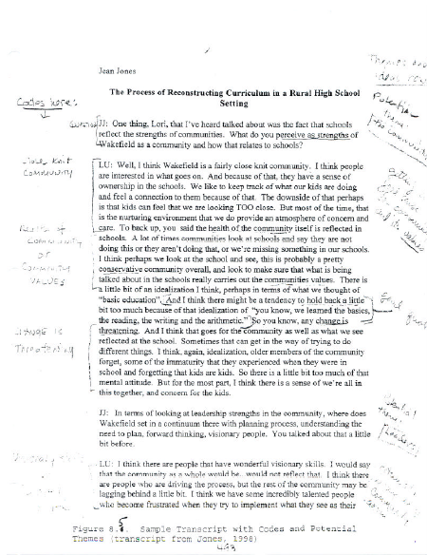

Slide 39
Developing Themes
Similar codes aggregated to form a major finding (Theme)
Usually 5-7 (2-4)
Identify themes by:
  Frequency
  Uniqueness
  Most evidence to support them
Use specific quotes as supporting evidence

Slide 40
Developing Themes
Different types of themes
  Ordinary themes
  Unexpected themes
  Hard-to-classify themes
  Major and Minor themes
Themes represent multiple perspectives of the participants
Once themes are developed look for contrary evidence

Slide 41
Connecting themes
Layering the analysis
  Representing the data using interconnected levels of themes
Going beyond merely stating themes
Minor themes are subsumed by major themes
Major themes lead to broader themes
Working upward toward broader and broader themes

Slide 42
Analysis Seeks to Enlighten
Analysis should lift the level of understanding to a new level
Analysis should inspire a search for new information

Slide 43
Technology Tools
http://www.surrey.ac.uk/sociology/research/researchcentres/caqdas/support/choosing/index.htm

Slide 44
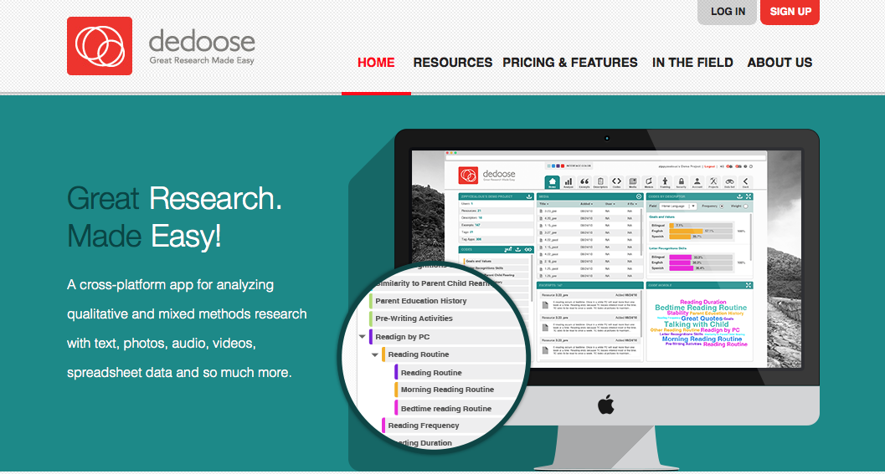
Technology Tools
Dedoose http://www.dedoose.com
Notes:
Stacy

Slide 45
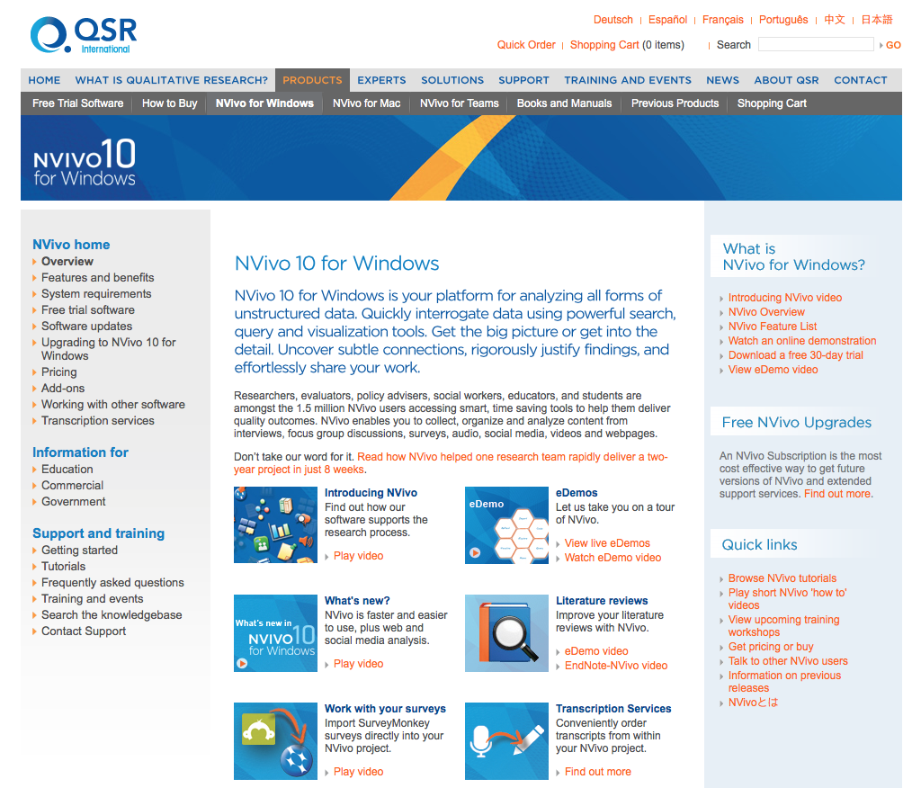
Technology Tools
Nvivo http://www.qsrinternational.com/products_nvivo.aspx
Notes:
Stacy

Slide 46
Questions or Comments
Ellen Meents-DeCaigny,
Assistant Vice President for Student Affairs,
DePaul University
emeentsd@depaul.edu

