Slide 1
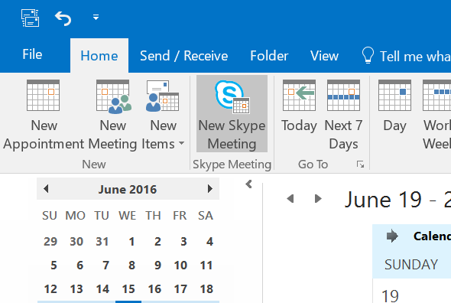
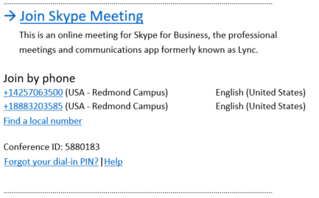
Quick Start Guide
Add a phone user to your conference
Using dial-in conferencing
From within the conference/meeting, select Invite More People.
Enter the person’s phone number and select OK.
The meeting will then call out the person and add them to the meeting.
Get started with dial-in conferencing
Using dial-in conferencing for Skype for Business couldn’t be easier. Instead of having to visit several sites to schedule the meeting, audio bridge, or other elements, you simply:
IMPORTANT! Remember to dial the full phone number of the person that you want to reach — including the country code and the ‘+’ symbol (e.g. +1 425 555-1234).
Open your calendar in Outlook.
Click New Skype Meeting.
That’s it! Your meeting is scheduled and your audio bridge is ready to go.
Dial into a Skype Meeting using a phone
From your mobile device, simply dial the phone number in the invitation.
When prompted, enter the Conference ID from the invitation.
1
2
Configure dial-in conferencing Options
From either your Outlook calendar, or within the meeting, you can open your meeting options menu. From that menu, you can:
Enable and disable entry and exit announcements.
Lock and unlock the meeting, managing the type of user that is:
Start a meeting using your telephone
Depending on how your organization has configured your service, you might need your Organizer dial-in conferencing PIN. This PIN was sent via email when you were enabled for the dial-in conferencing service.
If you are unable to remember your PIN, please contact your tenant admin.
Granted entry directly into the meeting.
Placed in the lobby (these users will need to be admitted by an organizer).
© 2016 Microsoft Corporation. All rights reserved.
This document is for informational purposes only. MICROSOFT MAKES NO WARRANTIES, EXPRESS OR IMPLIED.

