Slide 1
Laboratory Safety Training
Winter Quarter 2018

Slide 2
Please view this presentation as a slide show in order for the links to be active.
Navigate to the slide show tab at the top, then select “From current slide.”

Slide 3
’s Lab Standard
Click on the OSHA logo to read the standard!
Performing chemical procedures using small quantities of hazardous chemicals on a laboratory scale
Applies to laboratory use of hazardous chemicals
Requires DePaul to have a Chemical Hygiene Plan (CHP)
Lab personnel have many responsibilities under the CHP that are covered in this training, but a thorough review of the CHP is recommended
Employees must be provided with no cost medical consultations & examinations if necessary

Slide 4
What do you need to know when working with hazardous chemicals?

Slide 5
Specific hazards, including any posed by reactions/processes
Occupational exposure limits
How to detect their presence & signs of exposure
How to handle accidents & emergencies
Click the beakers to learn more about each topic

Slide 6
Know the Hazards
There are 2 main types of hazards posed by chemicals:
Health hazards
Toxic (acute, reproductive, specific organ), corrosive/irritant, carcinogenic, mutagen
Physical hazards
Explosive, flammable, pyrophoric, oxidizer, self-reactive, organic peroxide, gas under pressure
Manufacturer labels describe hazards
You must determine hazards of reactions
Back
SDS Section 2: Hazard(s) Identification & Section 10: Stability and Reactivity

Slide 7
Occupational Exposure Limits
OSHA set Permissible Exposure Limits (PELs) for many chemicals in 1970 – they recognize these are outdated and inadequate to protect workers’ health
See their Annotated PEL Tables for PEL values alongside other organizations’ more protective occupational exposure limits
SDSs list the PEL and the ACGIH® TLV®, and any other exposure limit used or recommended by the SDS preparer
If you think a respirator may be required, contact EHS
American Conference of Governmental Industrial Hygienists Threshold Limit Value
Back
SDS Section 8: Exposure Controls/Personal Protection

Slide 8
Detecting Presence & Signs of Exposure
For all chemicals you use…
Know how to detect their presence and accidental release
Consider all physical states they may appear in
Is there a recognizable smell? Color?
Know the signs of exposure. Common exposure symptoms include: eye, nose, throat, respiratory or skin irritation, fatigue, headache, dizziness, lightheadedness, coughing, wheezing, chest tightness, shortness of breath, nausea, coughing, vomiting
Be aware that some chemicals have DELAYED effects
Back
SDS Section 4: First-Aid Measures & Section 9: Physical and Chemical Properties

Slide 9
Handling Accidents & Emergencies
More on this later!
Being familiar with the info on the previous slides will better equip you to handle any accidents
Know the location of safety equipment in all areas you use
Phones, fire alarms, fire extinguishers*, eye wash stations, safety showers, spill kits¤, first aid kits
Use your judgment. If you cannot contain a dangerous situation:
CALL 911 and then alert Public Safety
*Only use a fire extinguisher ON A SMALL FIRE if you have received training
¤Ensure spill kits are stocked with appropriate materials to clean all spills you may encounter
SDS Section 5: Fire-Fighting Measures & Section 6: Accidental Release Measures

Slide 10
Safety Data Sheets (SDSs) contain all of this information & more!
SDSs received with shipments of hazardous chemicals must be retained and readily accessible to employees
How does your lab organize SDSs?
If the answer is “we don’t,” please contact EHS for assistance
If SDSs are accessed electronically…
A back up system must be in place in the event of power outages, equipment failure, etc.

Slide 11
How can you protect yourself and others from hazardous chemicals?

Slide 12
Build Safety In
Health and safety risks must be evaluated BEFORE starting new experiments/procedures
Methods to prevent chemical exposure must be included in standard operating procedures
Everyone who works in the lab must be aware of the hazards and how to protect themselves

Slide 13
Personal Protective Equipment
Appropriate lab attire:
Long sleeves & long pants
Closed-toe shoes
No jewelry
Pull long hair back
Safety goggles and nitrile gloves are appropriate for most lab work
Some chemicals require the use of different PPE – use what is recommended on SDSs
Do not touch doorknobs or leave the lab with contaminated gloves on
Do not wear synthetic fibers (polyester, nylon, etc.) when working with flammable materials – wear cotton
SDS Section 8: Exposure Controls/Personal Protection

Slide 14
Fume Hoods
Use to contain procedures whenever feasible
All materials should be 6 inches back from the sash plane
Keep sash completely closed when not in use
Only work with the sash at the suggested height or lower
All containers must be closed when not in use
Do not use for excessive storage – this affects airflow and reduces the hood’s ability to perform its function
All hoods are certified annually by a contractor
If you suspect a hood is malfunctioning, remove it from service and report to Facility Operations
Click the hood to view the
EHS Fume Hoods Manual

Slide 15
Lab Safety 101:
A review of the basics

Slide 16
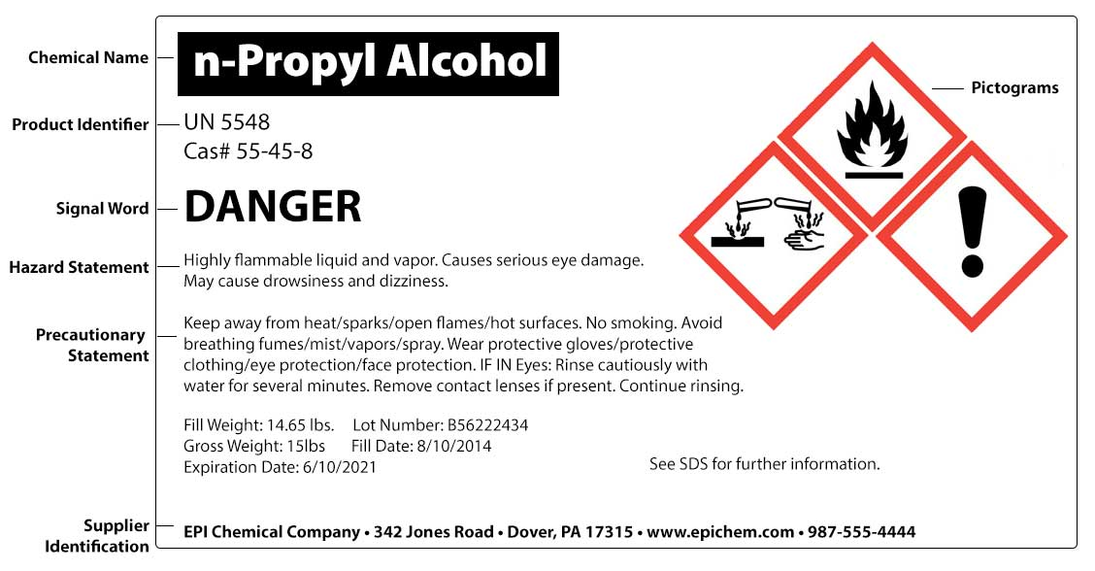
Understanding Chemical Labels
6 required sections for GHS compliant manufacturer labels
Click the label to download a poster explaining all
GHS pictograms

Slide 17
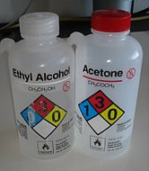
Labeling Your Containers
When you create containers…
You only have to label them with the CONTENTS
Even water + other non-hazardous substances must be labeled
It may be helpful to include additional information, but it’s not required
If bottles are too small for a label, letters/numbers that reference a log is acceptable as long as everyone in the lab is aware of this practice

Slide 18
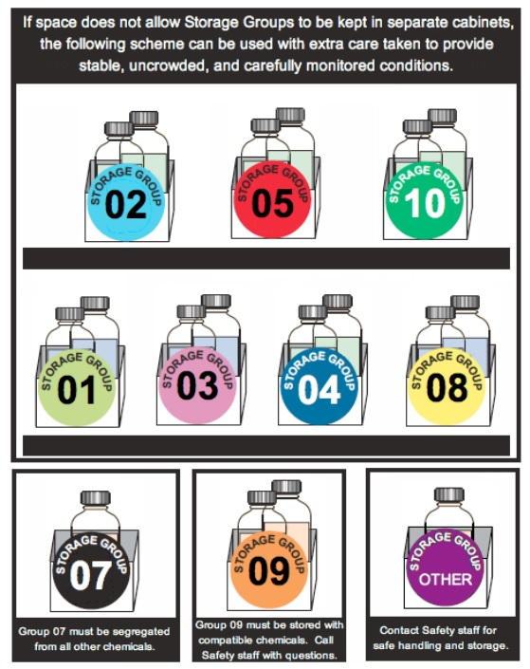
Safe Storage
It is much safer to segregate chemicals by hazard rather than alphabetically
Use any special cabinets you have as they are intended
It is a good practice to store all chemical containers in cabinets rather than on the lab bench or in hoods
Wash and dry glassware/equipment after use and promptly return to storage – do not let items build up in sinks
Click the image to view details on suggested storage groups (Source: The University of Vermont)

Slide 19
Waste Stream Overview
LABORATORY WASTE
CHEMICAL WASTE
PHYSICAL WASTE
BIOHAZARDOUS WASTE
-Most is considered hazardous waste – more details on next few slides
-Includes specimens in fixative (e.g., CaroSafeTM)
-Empty containers can be put in recycling or trash UNLESS they contained a P-listed waste (see Appendix A of the Waste Disposal Guide for a list)
-Consult with EHS for proper P-listed waste disposal procedures
-Lab debris (gloves, towels, plastic, rags, etc.) not contaminated with chemicals can be disposed of as regular trash. If contaminated, they are chemical waste
-Clean broken glass must be placed in designated boxes. Please ensure that full boxes are removed promptly according to departmental procedures
-Consult with EHS for proper disposal of mercury containing equipment
-All potentially infectious waste
(e.g., cultures and stocks, used sharps, blood or body fluids,
etc.)
-Must be placed in rigid containers labeled with the biohazard symbol and word “Biohazard:”
RADIOACTIVE WASTE
-Managed by Dr. Dean, contact him with any questions

Slide 20
EHS coordinates periodic pick ups of
chemical
& waste.
biohazardous
physical
For questions about waste,
contact Facility Operations.
(5-7377)

Slide 21
Hazardous Waste Storage
Most chemical waste you generate = hazardous waste
You are allowed to store up to 55 gallons of hazardous waste in your lab
This is called a Satellite Accumulation Area
Can accumulate as long as necessary
Keep waste clearly separated from materials in use
Take care not to create unknown waste which can be very expensive to characterize and dispose of
Ensure labels do not degrade due to chemical splatter
Label waste containers immediately

Slide 22
Hazardous Waste Labeling
Waste generated in your lab must be labeled with the following:
The words “Hazardous Waste”
Generator Name/Lab
All contents
EHS can provide you with labels
You may create your own as long as you include the above information
5-8985

Slide 23
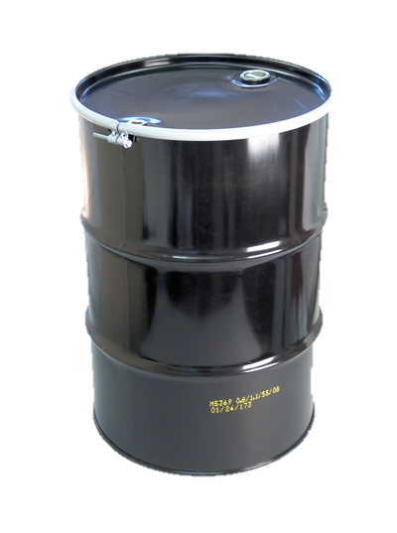
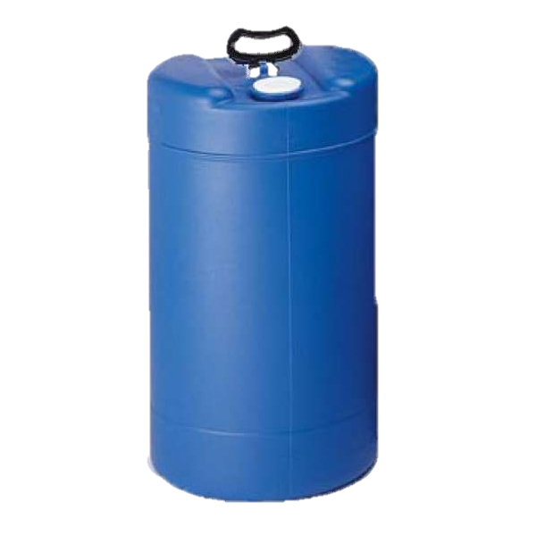
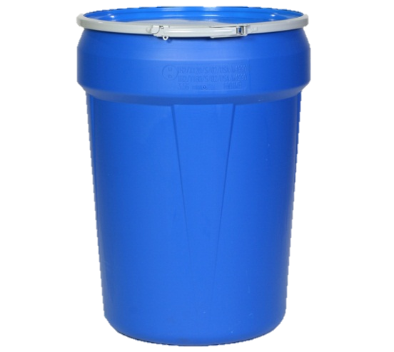
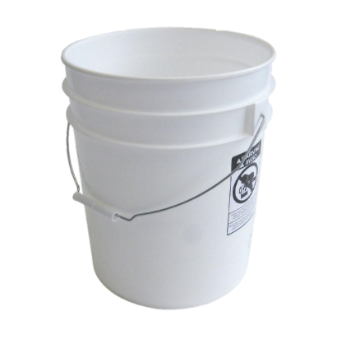
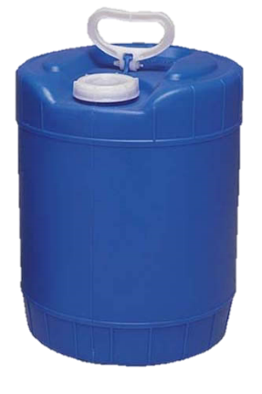
Supplies EHS Can Provide
All containers except bio bins and buckets can be open top (entire lid removable with bung) or closed top (small opening), and translucent or opaque plastic
43 gal “bio bins”
55 gal
30 gal
15 gal
5 gal buckets & “carboys”

Slide 24
Tips for Reducing Waste
Practice smart chemical procurement
Be realistic about the quantities you need
Bulk buys are not always a “good deal” when it comes time to dispose of them
Use Vertere to share with colleagues
Use the principles of green chemistry to design experiments that require less hazardous reagents and produce less waste

Slide 25
Non-Chemical Hazards
Click the pictogram to view the EHS Compressed Gas Safety Manual
Please watch this brief video on other lab hazards, including but not limited to:
Electrical shock
Extreme temperatures
Compressed gas cylinders
Slips, trips and falls
Do not chain cylinders together – each cylinder must be anchored separately to a sturdy surface
Store fuel gas cylinders at least 20 feet apart from oxygen cylinders
Place cap on cylinders when not in use
Have empty cylinders promptly removed according to departmental procedures

Slide 26
Emergency Procedures
Know all potential evacuation routes from your lab
Review the Emergency Plan for Hazardous Materials Incidents
If a chemical exposure occurs:
If the person is having trouble breathing or staying conscious, CALL 911 and then alert Public Safety
Assist the person in using the safety shower and/or eye wash station if needed
Review Section 9 of the CHP for detailed instructions, including information about notifying Public Safety
If you are unsure how to respond, call Illinois Poison Control at 1-800-222-1222. They are qualified to provide first aid instructions for exposures to any potentially hazardous substances
Remember to always keep aisles & exits clear and never block access to safety equipment
Whenever an exposure/accident/injury occurs, complete an EHS Incident Report Form in addition to Public Safety’s report

Slide 27
A Note on Lab Security
Be aware of your surroundings
Take note of anyone or anything suspicious and promptly report to Public Safety (5-7777)
If you don’t have an automatic locking door, lock whenever you leave
Review Public Safety’s recommended active shooter training
Consider sharing it with students as part of their safety training

Slide 28
Where can you get help with lab safety issues?

Slide 29
Lab Coordinators
Your departmental contacts for chemical procurement, waste disposal and general lab safety questions
Can assist you in using Vertere for chemical inventory and sharing
Health Sciences: Please contact EHS
Biology
Carolyn Martineau
5-7198
Chemistry
Sara Schjerven
5-7368
Env Science
Maggie Workman
5-7445

Slide 30
Environmental Health & Safety ehs.depaul.edu
O’Connell Hall, Suite 270
5-3344
ehsoffice@depaul.edu
Ask us anything!
We’re here to help make sure that DePaul is a safe place to work and learn.

Slide 31
Office of Research Services (ORS) research.depaul.edu
ORS promotes, facilitates and supports research, scholarship, teaching and creative activities
Some research requires approval by ORS committees
-Institutional Biosafety Committee (IBC)
-Institutional Animal Care and Use Committee (IACUC)
-Institutional Review Board (IRB), if research involves human subjects

Slide 32
Lab Class Safety Training
Will open on D2L the first day of classes:
Must be completed annually by all students taking a lab class
Covers multiple courses (e.g., if completed for BIO 101, does not need to be completed for CHE 101)
If a student fails twice, the instructor/TA must request a quiz reset from EHS
Please contact EHS at 5-3344 with any questions!
Tuesday, January 2nd

Slide 33
Lab Safety Resources
All links in this training and a few more are listed below for your convenience.
OSHA’s Lab Standard
Annotated PEL Tables
Are OSHA’s PELs Safe? OSHA Says No
DePaul’s CHP: Please note Appendices A-E contain guidance on chemical hazard categories, handling and storage, peroxide-formers, incompatible chemicals and flammable/combustible liquids
EHS Fume Hoods Manual
EHS Compressed Gas Safety Manual
EHS Incident Report Form
GHS Pictograms Poster
Storage Groups
EHS Waste Disposal Guide
Emergency Plan: Hazardous Material Incidents: Also contains guidelines for many other emergencies
Illinois Poison Center: 1-800-222-1222
Active Shooter Training
Chemical Safety information from the library’s Chemistry & Biochemistry Research Guide
Office of Research Services
Environmental Health & Safety

Slide 34
You’ve completed the training!
However – no one will know unless you sign our virtual sign in sheet.

