Slide 1
Laboratory Safety Training
Autumn Quarter 2019

Slide 2
Please view this presentation as a slide show in order for the links to be active.
Navigate to the slide show tab at the top, then select “From current slide.”

Slide 3
’s Lab Standard
Click on the OSHA logo to read the standard!
Performing chemical procedures using small quantities of hazardous chemicals on a laboratory scale
Applies to laboratory use of hazardous chemicals
Requires DePaul to have a Chemical Hygiene Plan (CHP)
Lab personnel have many responsibilities under the CHP that are covered in this training, but you should also thoroughly review the CHP.
Employees must be provided with no cost medical consultations & examinations if necessary

Slide 4
What do you need to know when working with hazardous chemicals?

Slide 5
Specific hazards, including any posed by reactions/processes
Occupational exposure limits
How to detect their presence & signs of exposure
How to handle accidents & emergencies
Click the beakers to learn more about each topic

Slide 6
Know the Hazards
There are 2 main types of hazards posed by chemicals:
Health hazards
Toxic (acute, reproductive, specific organ), corrosive/irritant, carcinogenic, mutagen
Physical hazards
Explosive, flammable, pyrophoric, oxidizer, self-reactive, organic peroxide, gas under pressure
Manufacturer labels describe hazards
You must determine hazards of reactions
Back
SDS Section 2: Hazard(s) Identification & Section 10: Stability and Reactivity

Slide 7
Occupational Exposure Limits
OSHA set Permissible Exposure Limits (PELs) for many chemicals in 1970 – they recognize these are outdated and inadequate to protect workers’ health
See their Annotated PEL Tables for PEL values alongside other organizations’ more protective occupational exposure limits
SDSs list the PEL and the ACGIH® TLV®, and any other exposure limit used or recommended by the SDS preparer
If you think a respirator may be required, contact EHS
American Conference of Governmental Industrial Hygienists Threshold Limit Value
Back
SDS Section 8: Exposure Controls/Personal Protection

Slide 8
Detecting Presence & Signs of Exposure
For all chemicals you use…
Know how to detect their presence and accidental release
Consider all physical states they may appear in
Is there a recognizable smell? Color?
Know the signs of exposure. Common exposure symptoms include: eye, nose, throat, respiratory or skin irritation, fatigue, headache, dizziness, lightheadedness, coughing, wheezing, chest tightness, shortness of breath, nausea, coughing, vomiting
Be aware that some chemicals have DELAYED effects
Back
SDS Section 4: First-Aid Measures & Section 9: Physical and Chemical Properties

Slide 9
Handling Accidents & Emergencies
More on this later!
Being familiar with the info on the previous slides will better equip you to handle any accidents
Know the location of safety equipment in all areas you use
Phones, fire alarms, fire extinguishers*, eye wash stations, safety showers, spill kits¤, first aid kits
Use your judgment. If you cannot contain a dangerous situation:
CALL 911 and then alert Public Safety
*Only use a fire extinguisher ON A SMALL FIRE if you have received training
¤Ensure spill kits are stocked with appropriate materials to clean all spills you may encounter
SDS Section 5: Fire-Fighting Measures & Section 6: Accidental Release Measures

Slide 10
PLEASE NOTE: All campus phones are able to dial 911 directly. - It is not necessary to include an extra 9 (but the call will still go through if you do).
9-911

Slide 11
Safety Data Sheets (SDSs) contain all of this information & more!
SDSs received with shipments of hazardous chemicals must be retained and readily accessible to employees
How does your lab organize SDSs?
If SDSs are accessed electronically…
A back up system must be in place in the event of power outages, equipment failure, etc.

Slide 12
How can you protect yourself and others from hazardous chemicals?

Slide 13
Build Safety In
Health and safety risks must be evaluated BEFORE starting new experiments/procedures
Methods to prevent chemical exposure must be included in standard operating procedures
Everyone who works in the lab must be aware of the hazards and how to protect themselves

Slide 14
Personal Protective Equipment
Appropriate lab attire:
Long sleeves & long pants
Closed-toe shoes
No jewelry
Pull long hair back
Safety goggles and nitrile gloves are appropriate for most lab work
Some chemicals require the use of different PPE – use what is recommended on SDSs
Do not touch doorknobs or leave the lab with contaminated gloves on
Do not wear synthetic fibers (polyester, nylon, etc.) when working with flammable materials – wear cotton
SDS Section 8: Exposure Controls/Personal Protection

Slide 15
Fume Hoods
Use to contain procedures whenever feasible
All materials should be 6 inches back from the sash plane
Keep sash completely closed when not in use
Only work with the sash at the suggested height or lower
All containers must be closed when not in use
Do not use for excessive storage – this affects airflow and reduces the hood’s ability to perform its function
All hoods are certified annually by a contractor
If you suspect a hood is malfunctioning, remove it from service and report to Facility Operations
Click the hood to view the
EHS Fume Hoods Manual

Slide 16
Lab Safety 101:
A review of the basics

Slide 17
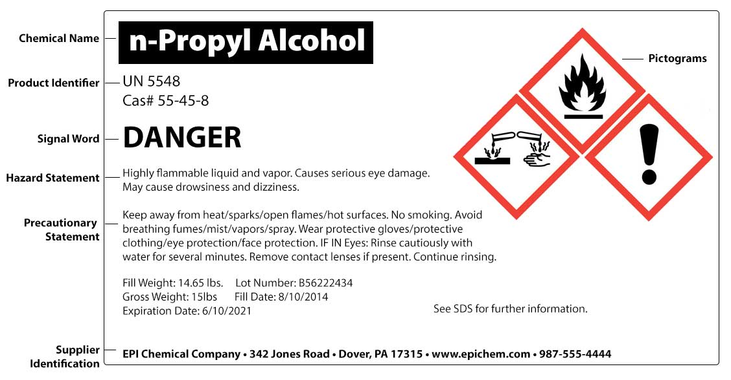
Understanding Chemical Labels
6 required sections for GHS compliant manufacturer labels
Click the label to learn the meaning of each pictogram.

Slide 18
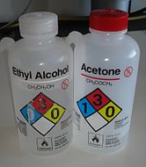
Labeling Your Containers
When you create containers (“secondary containers”) …
You only have to label them with the CONTENTS
Even water + other non-hazardous substances must be labeled
It may be helpful to include additional information, but it’s not required
If bottles are too small for a label, letters/numbers that reference a log is acceptable as long as everyone in the lab is aware of this practice

Slide 19
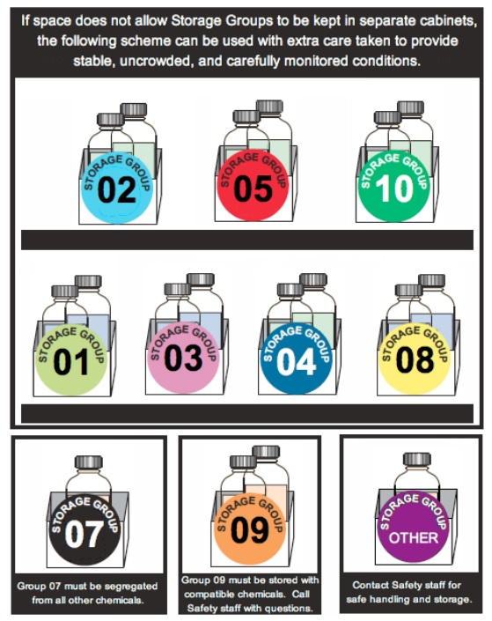
Safe Storage
It is much safer to segregate chemicals by hazard rather than alphabetically
Use any special cabinets you have as they are intended
It is a good practice to store all chemical containers in cabinets rather than on the lab bench or in hoods
Wash and dry glassware/equipment after use and promptly return to storage – do not let items build up in sinks
Click the image to view details on suggested storage groups (Source: The University of Vermont)

Slide 20
Laboratory waste
Hazardous waste
Radioactive waste
Biohazardous waste
Regular trash
Most of the chemical waste generated in labs is considered “hazardous waste” according to federal and state regulations.
Empty containers can be put in recycling or trash UNLESS they contained a P-listed waste (see Appendix A of the Waste Disposal Guide for the list).
Consult EHS for P-listed waste disposal procedures.
Please contact EHS when radioactive materials are purchased AND
when they are ready for disposal.
Includes all items considered “regulated waste” by OSHA’s Bloodborne Pathogens Standard and “potentially infectious medical waste” by the Illinois EPA. See DePaul’s Exposure Control Plan for more information.
Place in red containers labeled with the biohazard symbol and word “Biohazard”:
Use sharps containers for any objects that could puncture a bag.
Clean broken glass must be placed in designated boxes to protect custodial workers.
These boxes may be placed in any non-recycling dumpster when full. If you need help transferring them to a dumpster, please make a work order (janitorial) and leave them inside the lab for pick up.
Uncontaminated lab debris (gloves, towels, plastic, rags, etc.) can be disposed of as regular trash.

Slide 21
Hazardous Waste Storage
Most chemical waste you generate = hazardous waste
You are allowed to store up to 55 gallons of hazardous waste in your lab
This is called a Satellite Accumulation Area
Can accumulate as long as necessary
Keep waste clearly separated from materials in use
Take care not to create unknown waste which can be very expensive to characterize and dispose of
Ensure labels do not degrade due to chemical splatter
Label secondary and waste containers immediately

Slide 22
Hazardous Waste Labeling
Please label waste generated in your lab with the following:
Hazardous Waste
The words “Hazardous Waste”
Generator Name/Lab
All contents (can list the % of each if possible)
EHS can provide you with labels or you may create your own.
5-8985

Slide 23
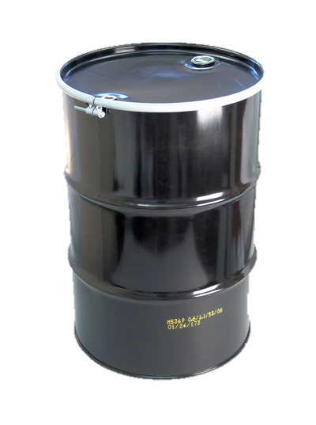
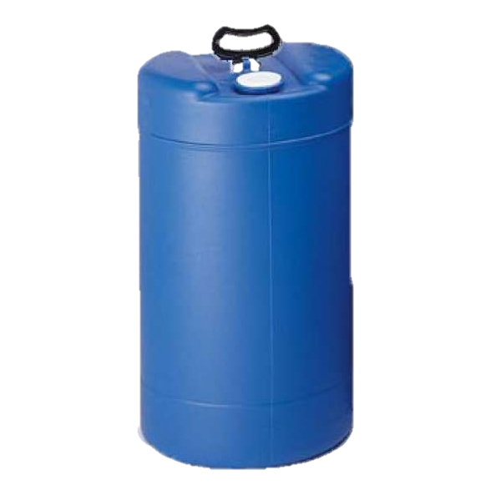
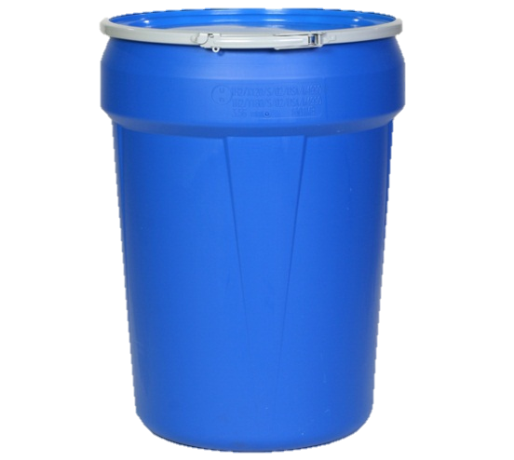
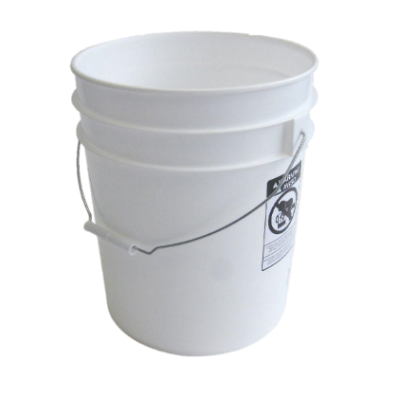
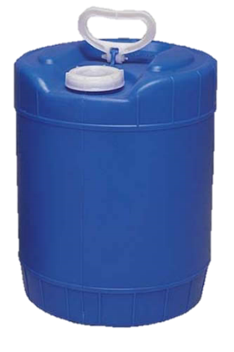
Supplies EHS Can Provide
All containers (except bio bins) can be open top (entire lid removable) or closed top (small opening), and translucent or opaque plastic
43 gal “bio bins”
55 gal
30 gal
15 gal
5 gal buckets & “carboys”

Slide 24
Bio Bins
Each bio bin comes with a liner. Place all waste inside this liner and make sure it does not slip down. It must be tied shut before the bin is transported off-site.
Sharps and anything that could puncture the liner must be put in a hard-walled container prior to placement in a bio bin.
When bins are ¾ full, please contact EHS for pick up.

Slide 25
Tips for Reducing Waste
Practice smart chemical procurement
Be realistic about the quantities you need
Bulk buys are not always a “good deal” when it comes time to dispose of them
Use Vertére to manage your inventory and share with colleagues
Use the principles of green chemistry to design experiments that use less hazardous reagents and produce less waste

Slide 26
Non-Chemical Hazards
Click the pictogram to view the EHS Compressed Gas Safety Manual
Please watch this brief video on other lab hazards, including but not limited to:
Electrical shock
Extreme temperatures
Compressed gas cylinders
Slips, trips and falls
Do not chain cylinders together – each cylinder must be anchored separately to a sturdy surface
Store fuel gas cylinders at least 20 feet away from oxygen cylinders
Cap cylinders during transport and when not in use
Remove empty cylinders promptly and according to departmental procedures

Slide 27
Emergency Procedures
Know all potential evacuation routes from your lab
Review the CHP for spill response information and guidance on handling different types of chemical exposures
Know what emergencies could occur in your lab and review the Emergency Plan for Hazardous Materials Incidents
If a chemical exposure occurs:
If the person is having trouble breathing or staying conscious, CALL 911 and then alert Public Safety
Assist the person in using the safety shower and/or eye wash station if needed
If you are unsure how to respond, you can always call Illinois Poison Control for free and confidential assistance. They are qualified to provide first aid instructions for any potentially hazardous exposures.
Illinois Poison Control: 1-800-222-1222
Remember to always keep aisles & exits clear and never block access to safety equipment

Slide 28
Reporting
Remember that any time anyone experiences a medical emergency on campus, you are advised to call 911 immediately, and then Public Safety.
All accidents or injuries that occur on University property, whether life threatening or not, must be promptly reported to Public Safety so that a report can be issued.
Incidental (minor) spills need to be reported to Public Safety only if someone is injured or the situation poses danger to people or property.
Please notify EHS via online incident report form within 72 hours of all laboratory incidents involving hazardous chemicals (including incidental spills).
If an incident occurs related to an IBC protocol, please refer to the IBC Policy and Procedure Manual for additional reporting responsibilities.

Slide 29
A Note on Lab Security
Be aware of your surroundings
Take note of anyone or anything suspicious and promptly report to Public Safety at 773-325-7777 (5-7777 from campus phones)
If you don’t have an automatic locking door, lock whenever you leave
Review Public Safety’s recommended active shooter training
Consider sharing it with students as part of their safety training

Slide 30
Where can you get help with lab safety issues?

Slide 31
Lab Coordinators
Your departmental contacts for chemical procurement, waste disposal and general lab safety questions
Can assist you in using Vertére for chemical inventory and sharing
Health Sciences: Please contact EHS
Biology
Carolyn Martineau
5-7198
Chemistry
Sara Schjerven
5-7368
Env Science
Maggie Workman
5-7445

Slide 32
Environmental Health & Safety ehs.depaul.edu
O’Connell Hall, Suite 270
5-3344 ehsoffice@depaul.edu
Ask us anything!
We’re here to help make sure that DePaul is a safe place to work and learn.

Slide 33
Office of Research Services (ORS) research.depaul.edu
ORS promotes, facilitates and supports research, scholarship, teaching and creative activities
Some research requires approval by ORS committees
-Institutional Biosafety Committee (IBC)
-Institutional Animal Care and Use Committee (IACUC)
-Institutional Review Board (IRB), if research involves human subjects

Slide 34
Lab Safety Training
There are 2 types!
Students may need to complete both, depending on their role.
1
2
This training (that you are almost done with)!
Faculty, Staff & Students with Lab Duties
This training is required for faculty, staff, and students with lab duties other than taking lab classes (such as working in a research lab or TAing for lab classes). Whenever you have new students in your lab or TAing your classes, please make sure they complete this training. It can be accessed year-round here on EHS’ site and lasts for one calendar year.
Students in Lab Classes
Students who require this training will receive an email from noreply@depaul.edu explaining how to access it on D2L.
It includes a pass/fail quiz.
View your students’ quiz grades on CampusConnect by navigating to:
Self Service > Faculty Center > Safety Training Report.
Quiz Resets
Students have 2 attempts to pass (with a 70%). If a student fails twice, they must notify their instructor or TA. Instructors/TAs should contact EHS with the student’s DePaul ID and email address to request a quiz reset. EHS will notify the student and copy their instructor/TA when the quiz is ready to retake.
Troubleshooting
Please direct students experiencing technical or user error issues to EHS.
If for any reason a student cannot take the training and quiz through D2L, EHS will send them a PowerPoint version of the training and Word version of the quiz. EHS will notify their instructor when they have completed the quiz this alternative way.

Slide 35
Resources
All links in this training and a few more are listed below for your convenience.
OSHA’s Lab Standard
Annotated PEL Tables
Are OSHA’s PELs Safe? OSHA Says No
EHS Resources: Chemical Hygiene Plan, Exposure Control Plan, Fume Hoods Manual, Compressed Gas Safety Manual, Waste Disposal Guide and more
EHS Incident Report Form: For reporting any laboratory incidents involving hazardous chemicals (including minor spills)
Background on GHS compliance
GHS compliant pictograms
Suggested Storage Groups
OSHA’s Bloodborne Pathogens Standard
Vertére
Emergency Plan: Hazardous Material Incidents
Illinois Poison Center: 1-800-222-1222
Active Shooter Training
Chemical Safety information from the Library’s Chemistry & Biochemistry Research Guide
Environmental Health & Safety
Office of Research Services
Lab Safety Training for Faculty, Staff & Students with Lab Duties (year-round link for this training!)

Slide 36
You’ve completed the training!
Please record your completion using this virtual sign in sheet.

