Slide 1
The Mexican Consular Network in the United States
March, 2017

Slide 2
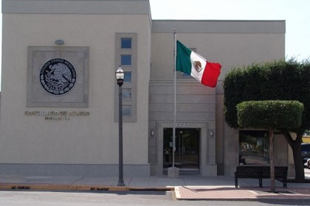
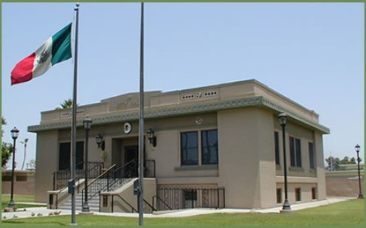
Facts
33.7 million people of Mexican origin in the US
11.4 million of them born in Mexico.
Mexico has the largest consular network of one country in another:
50 consulates in the US.
Notes:
Consulates are one of the most important assets of the diplomatic toolbox that countries use to conduct relations with one another, as set out in the Vienna Convention on Consular Relations of 1963, an international treaty signed and ratified by 173 nations including the United States. They are established in any given city through the formal authorization of the host government in accordance with the Vienna Convention.
Mexico’s consular assistance includes issuance of a wide range of official and governmental documents, orientation and legal services for its nationals, educational and health based initiatives, amongst others. These services not only aid Mexican nationals but also contribute to a positive spillover effect in local communities.
Mexican nationals living within a consular jurisdiction have the option of registering their personal information – i.e. current address and family contacts to reach out in case of emergency – and subsequently to be issued Consular Identification Cards. Referred to in Spanish as Matrículas Consulares, they represent proof of Mexican nationality and are issued solely upon a rigorous confirmation of nationality, local residence and identity. Matrículas Consulares have no bearing whatsoever on a person’s immigration status.
Mexico’s 50 consulates in the United States have a proven track record as partners for U.S. local, county and state governments, community organizations, business leaders, religious organizations and cultural institutions.

Slide 3
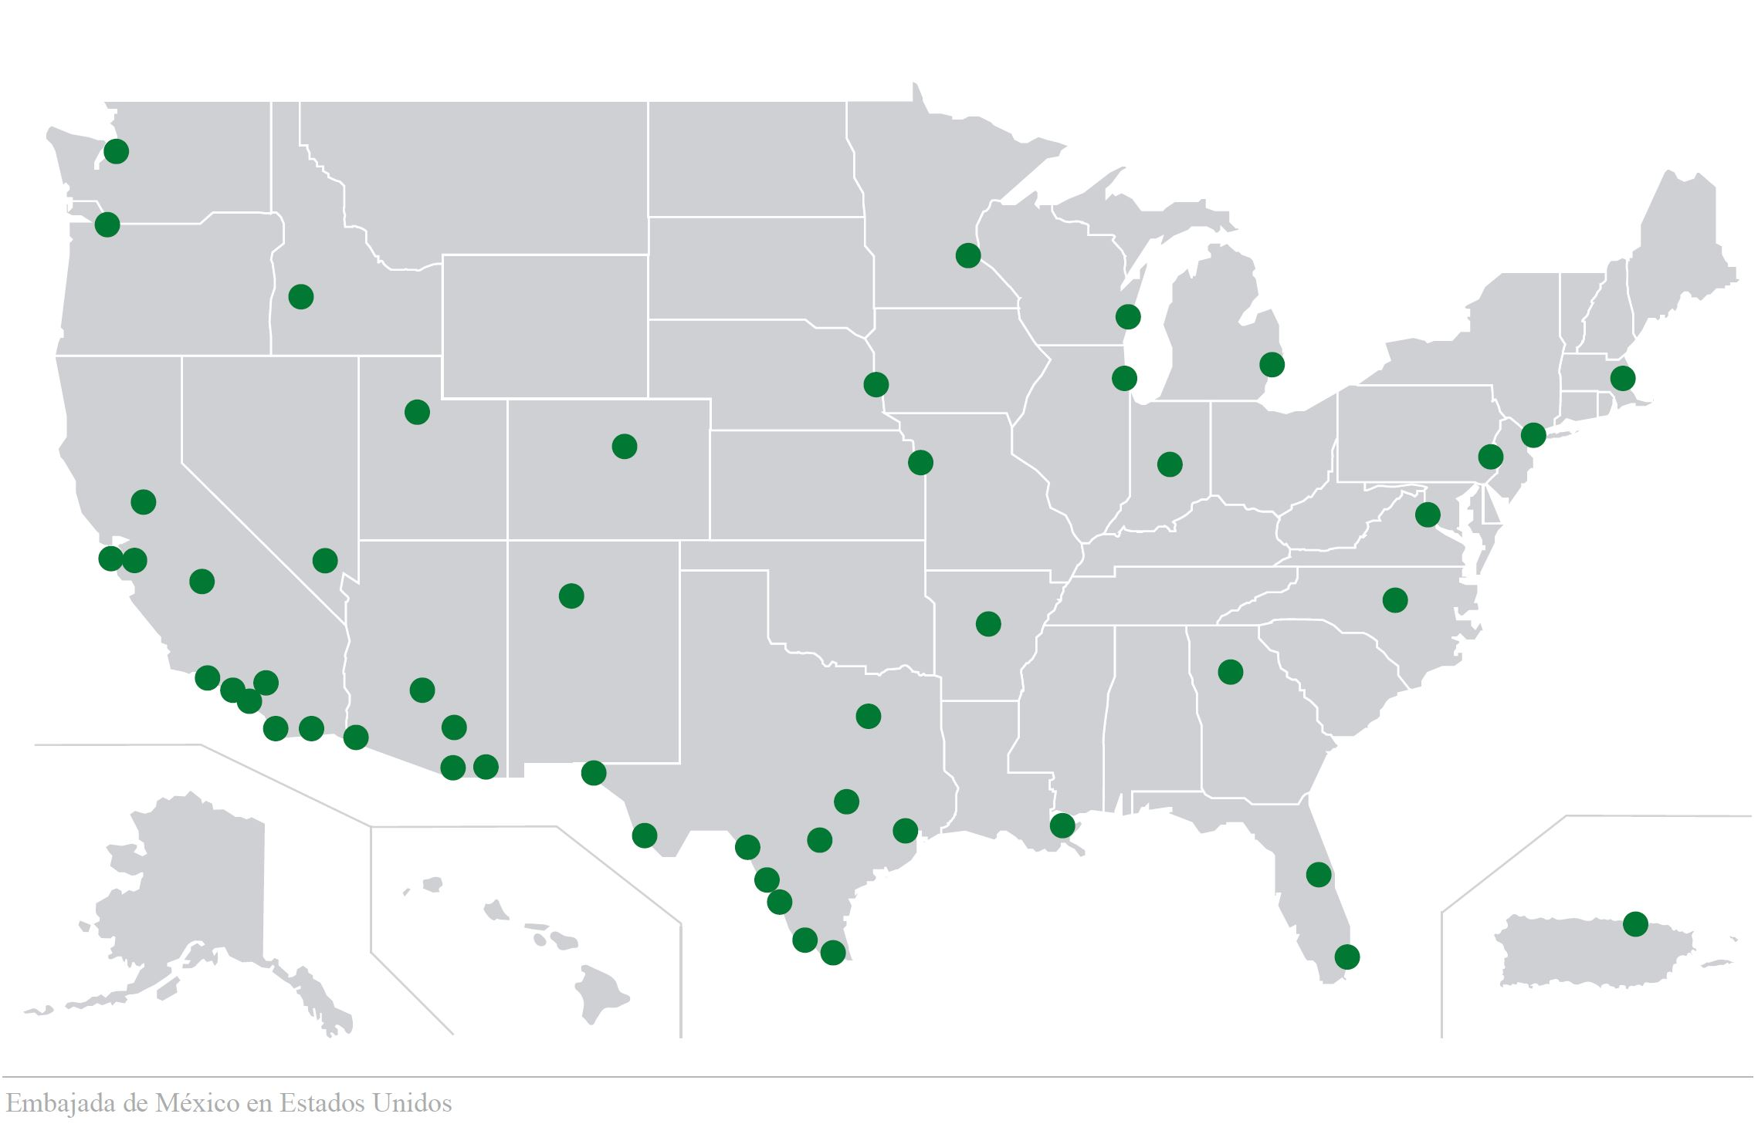
Consular footprint
Notes:
50 Consulates throughout the United States are part of the largest consular network any country has in another one single nation in the world. But beyond its size, this consular network has grown in reach and sophistication over the years and provides services few would imagine.

Slide 4
Main Services
Consular protection and assistance to Mexican nationals
Document services to Mexican and foreign nationals
Community outreach programs

Slide 5
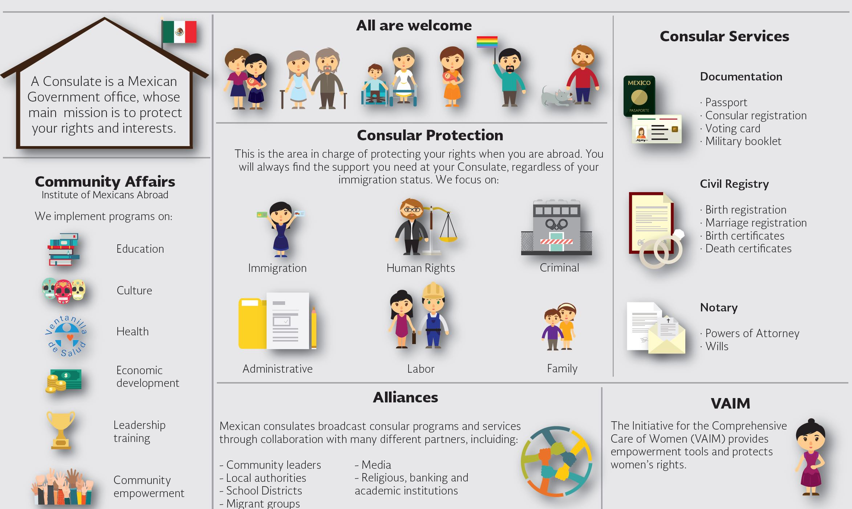
Scope of consular services

Slide 6
Main consular protection services
Emergency Passports
U Visa and WAVA cases
Legal assistance program (PALE)
Special attention to vulnerable populations
Assistance with medical repatriations
Workshops and informative sessions (DACA, Dual Citizenship, etc.)

Slide 7
Citizenship Awareness
In 2015 the Mexican consular network launched a dual citizenship awareness campaign, which includes the naturalization process in the US and registry of births abroad.
2.67 million Mexican LPR are eligible to become US citizens.
Mexico is the main country of origin among the eligible to naturalize population.

Slide 8
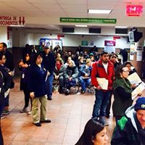
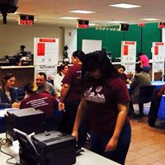
Citizenship
La mayoría de residentes elegibles son MEXICANOS.

Slide 9
Information tools
CIAM toll free number:
1 855 4636 395
Basic and updated information about immigration topics
Referral to consulates and legal services

Slide 10
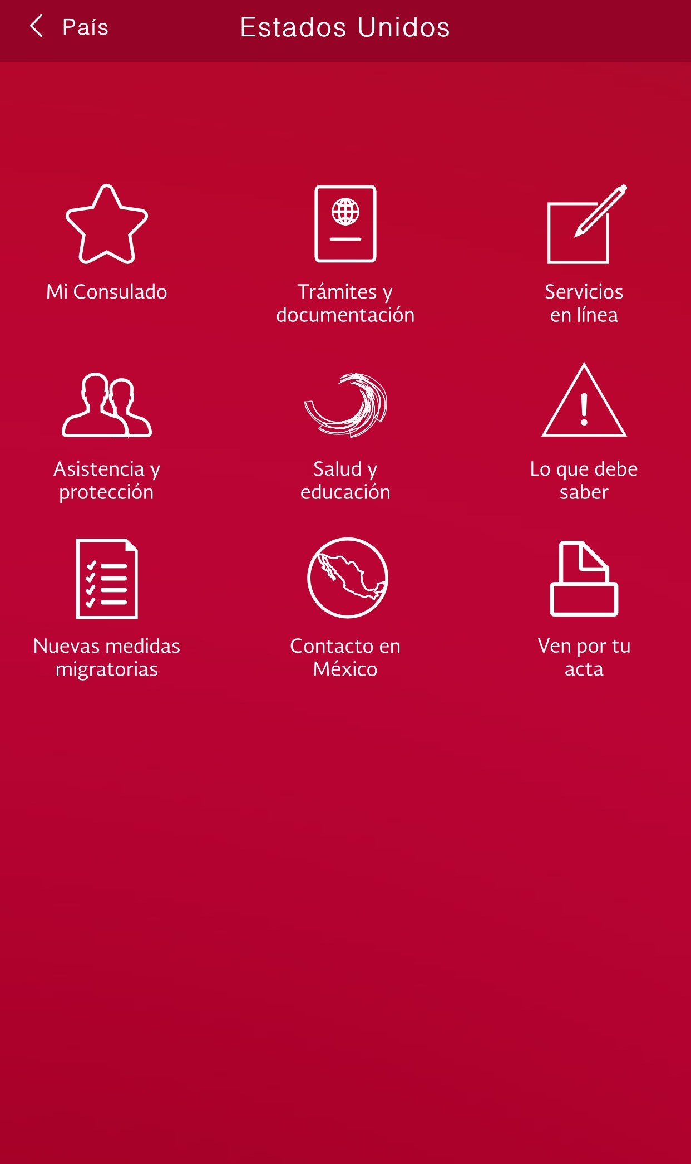
MiConsulmex App
Free consular services app
About 160,000 downloads
Available on Apple Store and Google Play
Has 9 sections with information in plain language
Constantly updated

Slide 11
Take away messages
Mexican consulates are a safe and trusted spaces to receive services and information.
Information tools are available for everyone, regardless of national origin or immigration status.
Referral and partnership opportunities.

Slide 12
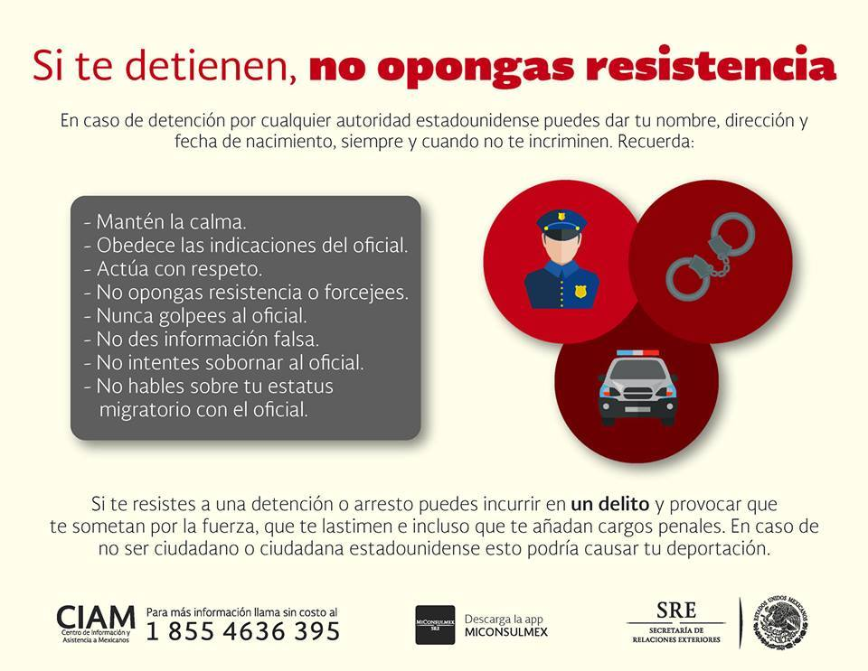
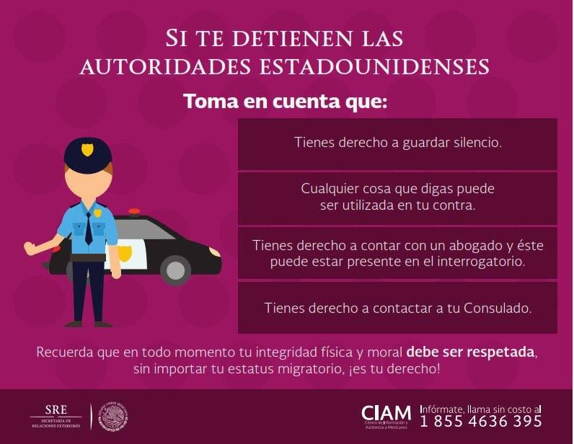
Know Your Rights

Slide 13
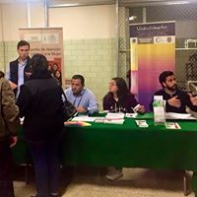
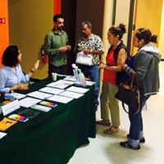

Slide 14
Contact information:
Consulate General of Mexico in Chicago
Marcelino Miranda
mmiranda@sre.gob.mx

